Slide 1
Don’t Obey in Advance
And Other Advice for this Dark Timeline

Slide 2
Why Are We Here?
Knowledge is Power.
You have questions and I can help.
Solidarity is necessary, especially now.
This is an information/knowledge dump.
More hands on stuff can be done later.

Slide 3
WARNING!
Firstly you do not have as much privacy as you think.
Secondly you will not be able to realistically avoid all potentially compromised services, applications, and activities.
The goal is to minimize risk, not eliminate it.

Slide 4
Definitions

Slide 5
Privacy
The state or condition of being free from being observed or disturbed by other people.

Slide 6
Security
The state of being free from danger or threat.

Slide 7
Risk
A situation involving exposure to danger.

Slide 8
Vulnerability
The quality or state of being exposed to the possibility of being attacked or harmed, either physically or emotionally.

Slide 9
Encryption
The process of converting information or data into a code, especially to prevent unauthorized access.

Slide 10
Authentication and Multifactor Authentication
The process or processes of proving your identity to a system.

Slide 11
Your Data and Keeping It Safe

Slide 12
What Is Data?
Facts and statistics collected together for reference or analysis.
You are data.
Anything you write, think, create, store, read, or access is all data.

Slide 13
Data At Rest
Data that is stored on a medium, such as a hard drive or disk.
Often encrypted.
Generally you need to login to access data at rest.
Build a process to encrypt and purge data.

Slide 14
Social Media
Your posts, updates, photos, “check-ins” and other social media actions are DATA.
Even what you don’t share is data used by the social media company.
Limit what you post, when you post, and with whom.

Slide 15
Data Sharing Services
Think Dropbox, Onedrive, and other file sharing services.
Yes, the hosts have access.
No, not a valid backup strategy.
Restrict access and remove access regularly.

Slide 16
Backup Your Data
Not everything needs to be backed up.
Find a process that works for you.
External USB drive + cloud + safe.
Make this a regular process.

Slide 17
Authentication and MFA

Slide 18
Authentication
Prove who you are.
Username + Password (One Factor)
Username + Password + MFA = Multifactor
What you have, What you are, Where you are, What you are doing.

Slide 19
MFA
SMS/Text: Good enough for you.
OTP = One Time Passcode
TOTP = Timed One Time Passcode
Authenticator Apps: Microsoft Authenticator, Google Authenticator, Authy
  Choose one app, use everywhere possible

Slide 20
MFA
Yubikey / Hardware token == BEST
Face ID: Big Nope
Fingerprint: Yes but know how to disable on phone!!
Turn on MFA everywhere. EVERYWHERE.

Slide 21
Managing Passwords
Password <<< Passphrase
Use a password manager (Bitwarden)
Change only when needed.

Slide 22
Communication and Secure Comms

Slide 23
Encryption
Most comms have encryption.
Prevents a third party from snooping.
Not encrypted on your device.
Does not prevent a party from disclosing.

Slide 24
Insecure Comms
Text/SMS is not secure.
Email is not secure.
Most social media “DMs” are not secure.
Talking on a phone is not secure.

Slide 25
Secure Comms
Options exist.
Signal is end-to-end encrypted and encrypted on the device.
  A party can still disclose!
Text can be encrypted for use on insecure comms. High difficulty.

Slide 26
VPNs
A tunnel between your device and the internet.
Prevents local network and ISP from snooping.
Easy to use!
Opt for a paid VPN over a free one.
  NordVPN

Slide 27
Social Media
There is no secure social media.
Consider everything to be publicly readable. Consider that the org can read anything you set to private.
Admins always have full access by design.

Slide 28
Social Media
If it is free then your data is what they want.
You don’t control what they do with your data.
No, posting a cryptic thing is not valid. Don’t do that. Stop it.

Slide 29
Social Media
Stop taking quizzes! This is simply data collection.
Restrict who you share with.
Restrict what you share!
Yes, social media is regularly monitored by law enforcement agencies.

Slide 30
Social Media
Meta/Insta/Twitter/Etc… most have algorithms designed to manipulate you.
You are easily manipulated through emotion.
Social media + algorithms to engage == dopamine hits == addiction.
Dead Internet Theory
  https://en.wikipedia.org/wiki/Dead_Internet_theory

Slide 31
Social Media
Not all social media is the same!
Fediverse: The Fediverse is a collection of social networking services that can communicate with each other (formally known as federation) using a common protocol. Users of different websites can send and receive status updates, multimedia files and other data across the network. The term Fediverse is a portmanteau of federation and universe.

Slide 32
Social Media
Fediverse -> Mastodon
Mastodon == Twitter/Facebook
Pixelfed == Insta
PeerTube == YouTube
Lemmy == Reddit
Remember IRC? Early blogs? RSS Feeds?
Individual Instances (servers/hosts/topics)

Slide 33
Is “XYZ” Secure?

Slide 34
Is Something Secure?
It Depends!
Is it a free product/service or paid?
Who or what owns it? Domestic/foreign?
Think outcome before looking for a tool/service/product. What is your end goal?

Slide 35
Is Something Secure?
Ask someone in the know.
Ask people like me.
There must be some trust otherwise you’ll never move forward.
Trust but verify.
  “I trust everyone. I just don’t trust the devil inside them.”

Slide 36
Operating Environments

Slide 37
Microsoft vs Apple vs ??
Microsoft Windows is the dominant operating environment on the planet.
Apple is the close second.
Everything else is a distant third.

Slide 38
Microsoft vs Apple vs ??
Microsoft has a terrible track record for security and privacy rights.
Apple can be more secure by default and often takes your privacy more seriously.

Slide 39
Microsoft vs Apple vs ??
Microsoft CoPilot + Recall: Takes screenshots of your desktop and applications.
Stores this data locally.
Used to train local AI.
Easy for threat actor to steal.

Slide 40
Microsoft vs Apple vs ??
Apple AI is less intrusive and more secure by default.
I recommend disabling all local AI whenever possible regardless of vendor.

Slide 41
Linux?!?!?!
“Linux” is a generic term.
The world runs on Linux. Your Android phone is Linux.
Built by companies and volunteers.
Open source and free.
It’s a philosophy in some ways.

Slide 42
(Philosophy Lesson)
It’s a philosophy in some ways.
Hacker Manifesto: https://phrack.org/issues/7/3
This is our world now... the world of the electron and the switch, the beauty of the baud. We make use of a service already existing without paying for what could be dirt-cheap if it wasn't run by profiteering gluttons, and you call us criminals. We explore... and you call us criminals. We seek after knowledge... and you call us criminals. We exist without skin color, without nationality, without religious bias... and you call us criminals. You build atomic bombs, you wage wars, you murder, cheat, and lie to us and try to make us believe it's for our own good, yet we're the criminals.
Yes, I am a criminal. My crime is that of curiosity. My crime is that of judging people by what they say and think, not what they look like. My crime is that of outsmarting you, something that you will never forgive me for.
I am a hacker, and this is my manifesto. You may stop this individual, but you can't stop us all... after all, we're all alike.

Slide 43
Linux?!?!?!
Common Linux Distributions include:
  Ubuntu (KUbuntu is very friendly)
  Linux Mint
  Fedora
SteamOS from Valve is focused on PC gaming.

Slide 44
Linux?!?!?!
Linux is more secure than Microsoft Windows by default.
Linux bakes security in by default.
Not highly targeted for malware, yet.

Slide 45
Apple vs Android vs ??
It’s Apple or Android.
Both work fine. User preference.
Keep up to date!
Use biometrics + PIN.
Don’t use faceID.
Know how to disable biometrics in an emergency!

Slide 46
OpSec and Physical Considerations

Slide 47
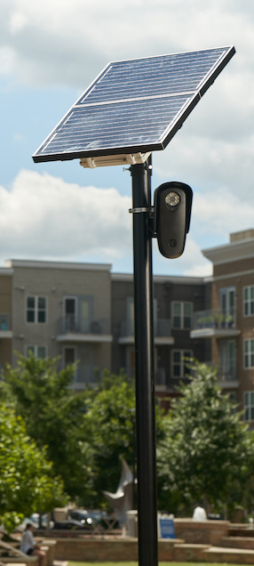
OpSec
Operational Security.
Precautions and actions taken to secure your daily lives and missions.
Who, What, When, Where, Why, How.
Exits and Cameras.

Slide 48
Physical Considerations
Don’t stand out in a crowd. Mitigate calling attention to yourself.
Avoid mobs.
Protest carefully and understand when to leave.

Slide 49
Physical Considerations
Make good use of facial covering if needed.
Hats, scarves, and jackets make good disguises.
Follow the laws as directed. You being gone doesn’t help anyone.

Slide 50
Know Your Rights

Slide 51
You Have Rights
The Constitution
State Law
Never answer questions without an attorney. Make them follow the law.
Be Respectful. It’s hard. Do it anyways.
PRACTICE your rights.

Slide 52
Classic Resources for Living in a Fascist State

Slide 53
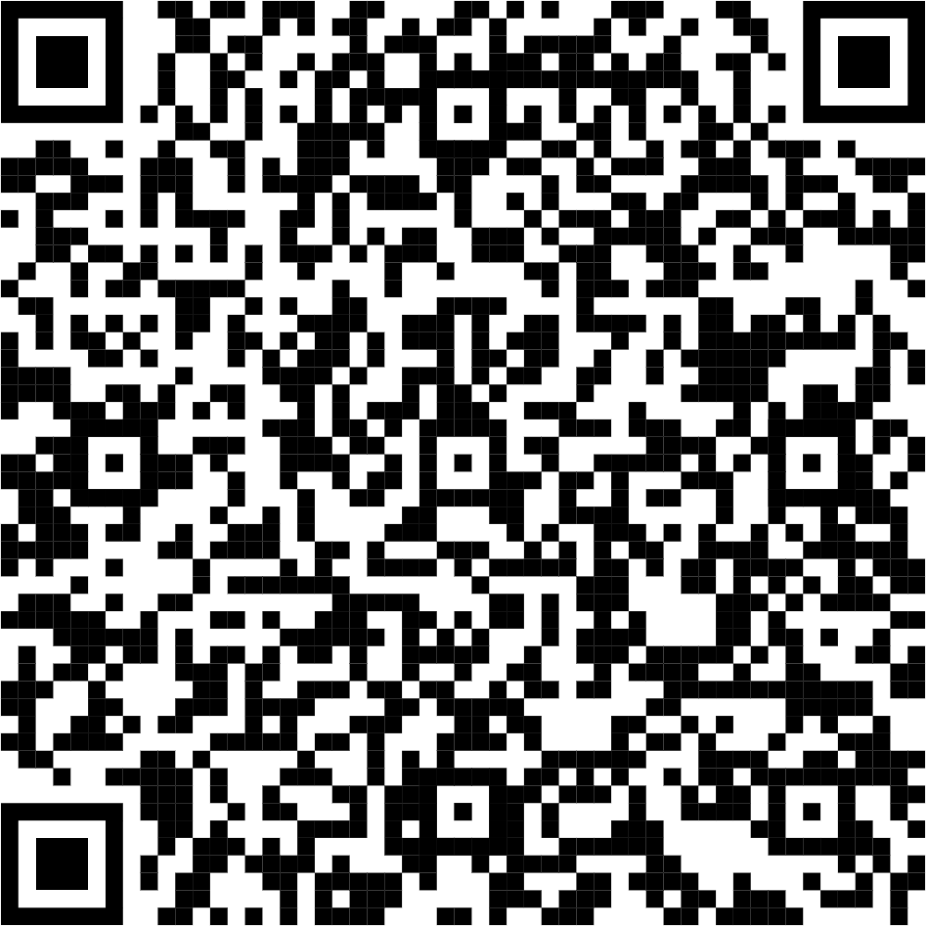
Anarchist Cookbook
Full of interesting knowledge.
Not illegal to read or have (yet).

Slide 54
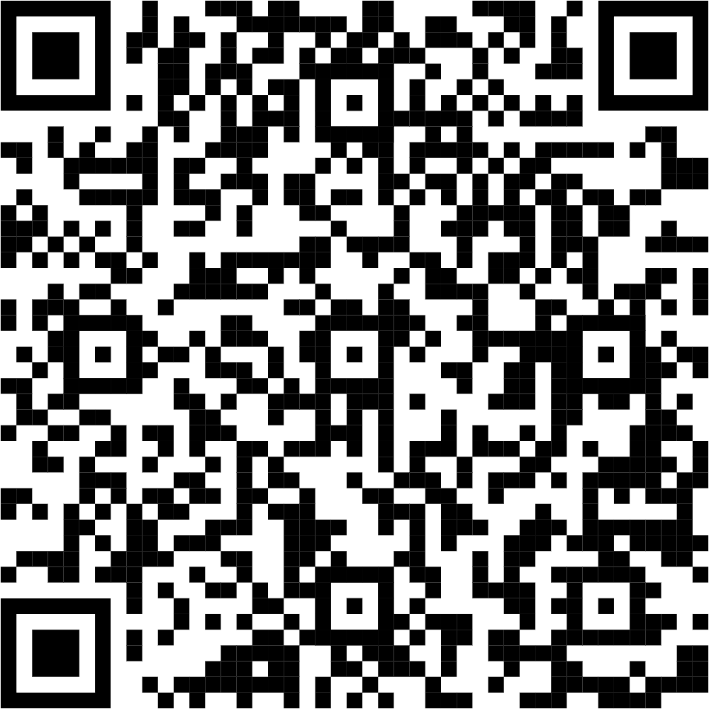
Simple Sabotage Field Manual
Written by America and distributed to civilian populations during WWI and WWII.
Available at the CIA website.
Tips/tricks for surviving and undermining.

Slide 55
All Files + Presentation
https://github.com/maloleyr/rebel

Slide 56
Focus
You
Yours
Small Bubble
Larger Bubble
Actions you can take
You cannot solve it all alone

Slide 57
QA

